Slide 1
LENDING CLUB CASE STUDY SUBMISSION
Group Members:
Niraj Kumar
Arjun Ashok Kumar

Slide 2
Lending Club Case Study Analysis
Lending Club is the largest online loan marketplace, facilitating personal loans, business loans and financing of medical procedures. It's largest source of credit loss is lending loans to ‘risky’ applicants.
Lending Club wants to identify the risky loan applicants, so that such loans can be reduced thereby cutting down the amount of credit loss.
Our aim is to find the driving factors behind loan getting default.

Slide 3
Problem solving methodology
DATA PREPARATION
DATA ANALYSIS
Removing the null valued columns, unnecessary variables and checking the null value percentage and removing the respective rows.
Read the csv files using proper encoding.
Analyzing the continuous data columns with respect to the categorical column.
Analyzing the two variable behavior like term and loan status with respect to loan amount.
Check for outliners and remove unwanted
records
Analyzing each column, plotting the distributions of each column.
Analyzing all plots and recommendations for reducing the loss of business by detecting columns best which contribute to loan defaulters.

Slide 4
Data Cleaning
We have removed all variables with mostly missing data.
We have also customer behavior columns such as revolving balance, next payment date, etc. as these details are not available at the time of application.
All current loans were not included in the analysis as the loan term is still in process and the data won’t yield any meaning full information.
For categorical variables with some missing values, we have considered them as a separate category.

Slide 5
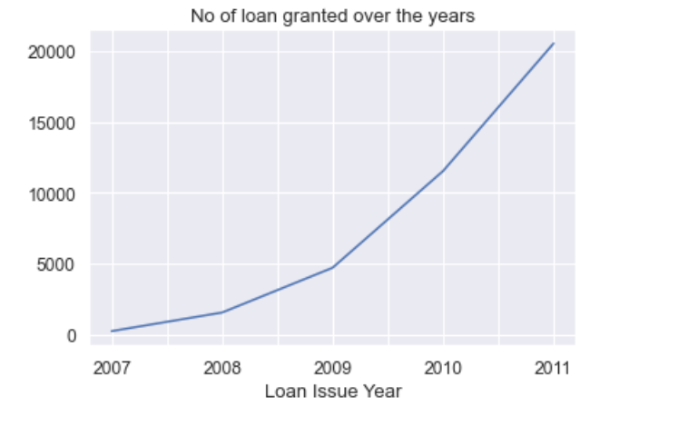
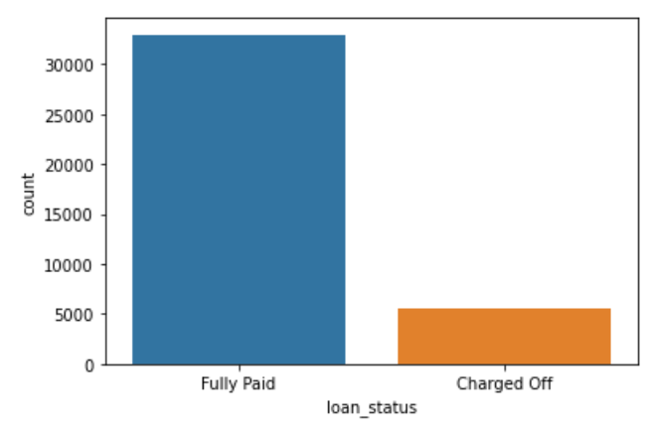
Loan Status Analysis
Observations:
1. Most of the loans are Fully Paid.
2. About 14% of loan are having status as defaulters.
3. The loan has been increasing exponentially over the years.

Slide 6
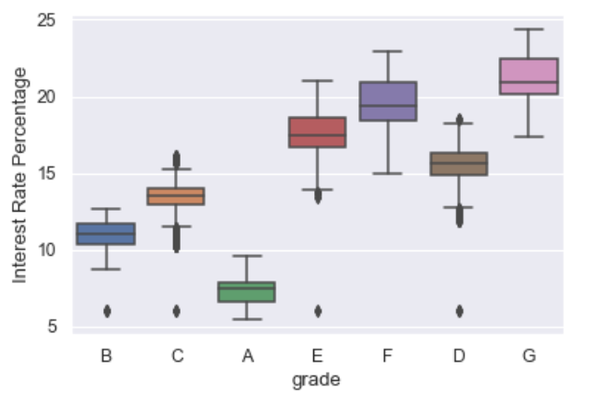
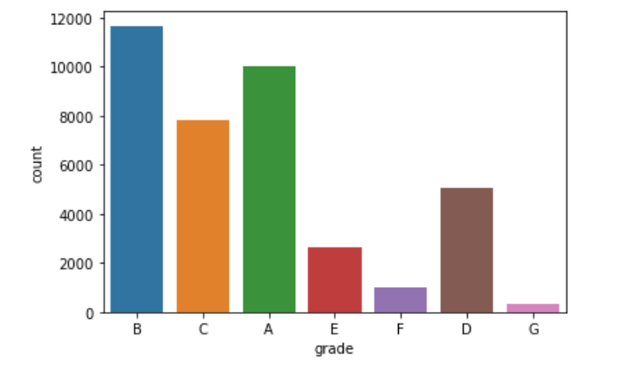
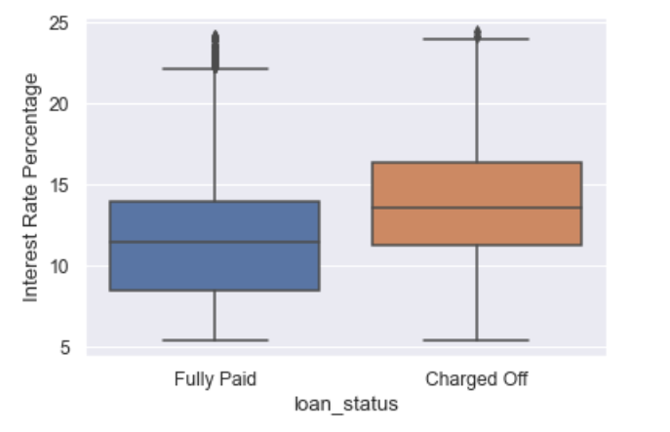
Loan Grade Analysis
Observation:
1. Most of the loans have grade of A and B. Therefore stating
most of the loans are high graded loans.
2. High Quality loans have low interest rate.
3. Higher interest rate have higher tendency to
default the loan

Slide 7
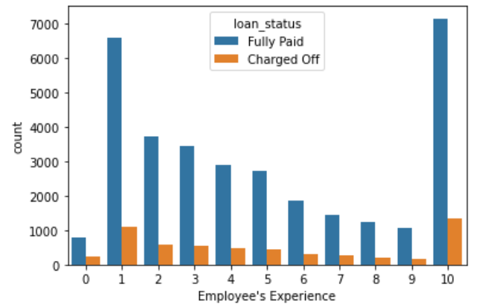
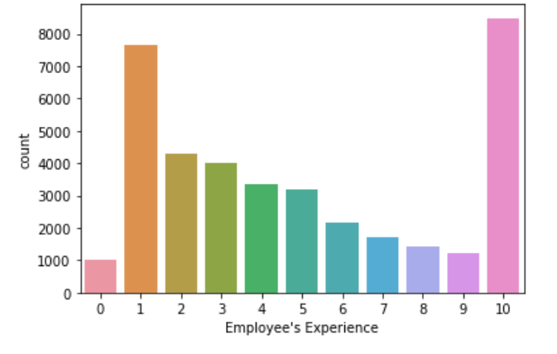
Loan Applicants Work Experience Analysis
Observation:
1. Majority of employees applying for the loan have more than 10 years of experience
2. Tendency of person to default the loan with 10 years of experience is also high. So company need to be careful
when granting loan.

Slide 8
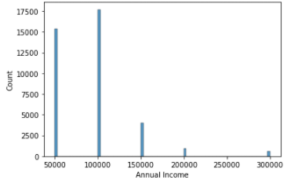
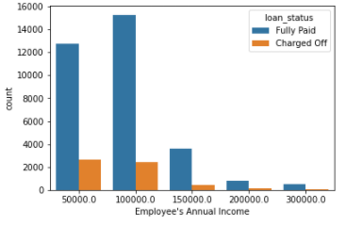
Loan Applicant’s Annual Income Analysis
Observations:
The number of loans are higher for under the 100000 annual income
The number of defaulters are also higher in this segment. But this could be because of the higher number of loans and may not be a driving factor for the defaulters.

Slide 9
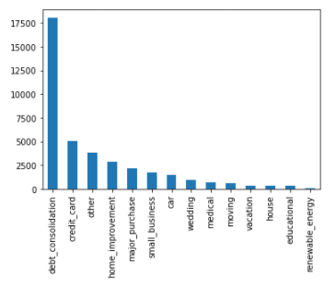
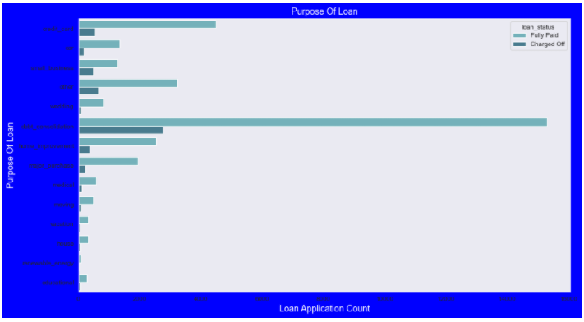
Purpose of Loan Analysis
Observation:
- Debt consolidation has the highest number of loans. It also has the highest number of defaulters. This is some thing to look out for new applicants.

Slide 10
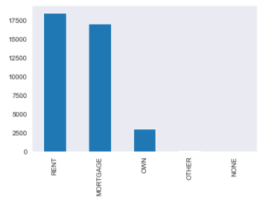
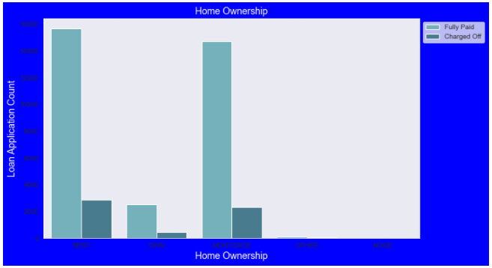
Home Ownership Analysis
Observation:
- People with rent and mortgage commitment seems to take more loans. They also have higher number of defaulters. This

Slide 11
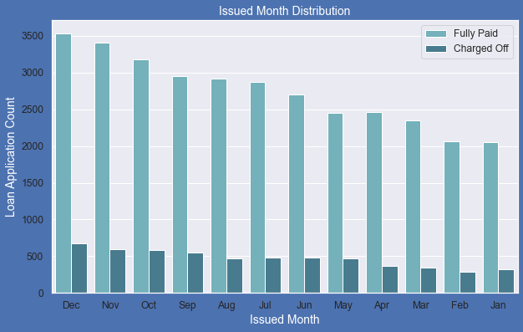
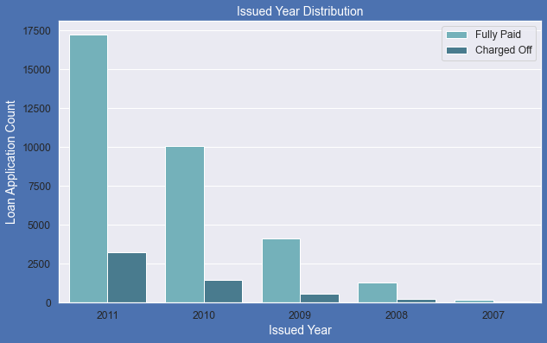
Issued month and year analysis
Observation:
The number of loans issued increases each year as well as through out the year.
The defaulter count remains consistent with the change in loan applicaitions.

Slide 12
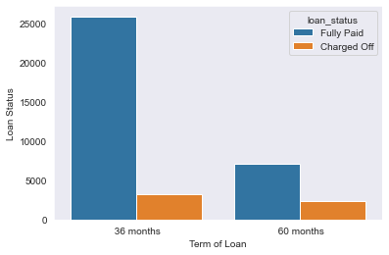
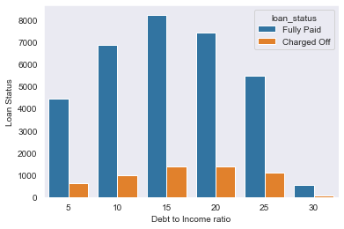
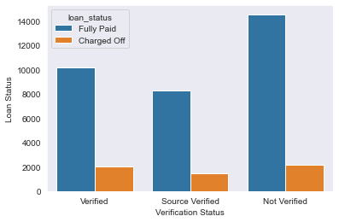
Term, Debt to Income, and Verification Status Analysis
Observation:
- The standout point is that the percent of defaulters for the 60 month term is considerably higher. This is another variable to look out for.

Slide 13
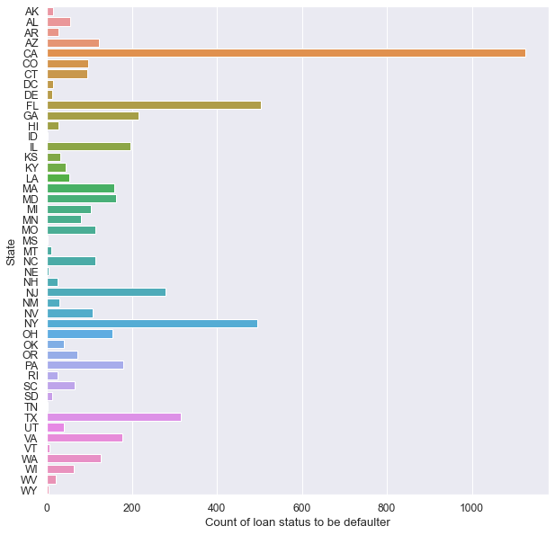
Analysis by state
Observation:
California(CA) has the highest number of defaulters. This should be considered during the loan approval.
Florida(FL) and New York(NY) also have high number of defaulters and should be considered during the approval process.

Slide 14
Conclusions
To conclude the following variable stands out when trying to identify defaulters:
Purpose: debt consolidation had more defaulters compared to others.
Address state: Applicants from California particularly were highly likely to default. Florida and New York also showed higher number of defaulters.
Interest rate: The applicants were more likely to default with higher interest rates.
Term: The percent of defaulters were higher for loans with 60 month term.

